Slide 1


A Survey on Machine Learning Applications for
Software Defined Network Security
J. Arévalo - Universidad Santo Tomás de Colombia
J. E. Camargo - Universidad Nacional de Colombia

Slide 2
Background, Goals and Methodology

Slide 3
Background, Goals and Methodology
1990s
SVM RNNs become popular.
2000s
SVC, unsupervised ML become widespread.
2010s
Processing allows DL, ML widely used.
Computer Misuse Act UK, digital signatures, Floodnet. General public awareness
ILOVEYOU, GTbot, Melissa, Anonymous, Albert Gonzalez steals over 170M CC
ForCES (rfc3746) proposed by IETF. Ethane generates Openflow and NOX
Stuxnet,Wikileaks, Wannacry. Exponential increase in cybersecurity incidents each year
OpenVS by Nicira, Floodlight, ONF, VMWare bought Nicira, Google B4 network, ETSI presents NFV, ODL, P4 language

Slide 4
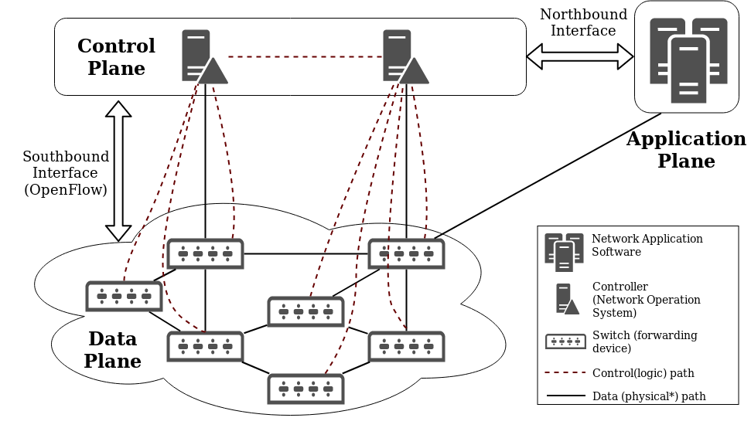
Background, Goals and Methodology
Notes:
Separation of control and data plane
Openflow as enabler
flow is a set of packets with similar features that go from one
endpoint (or group) to another endpoint (or group) in a single direction

Slide 5
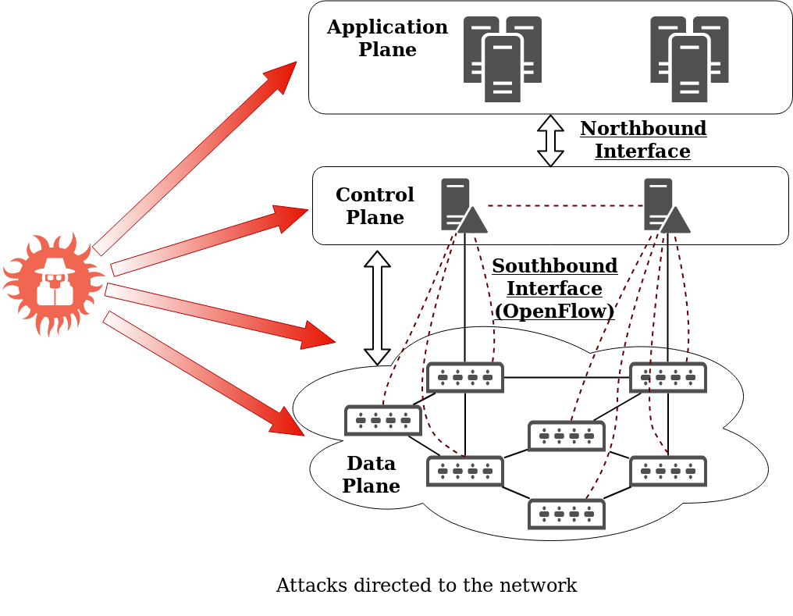
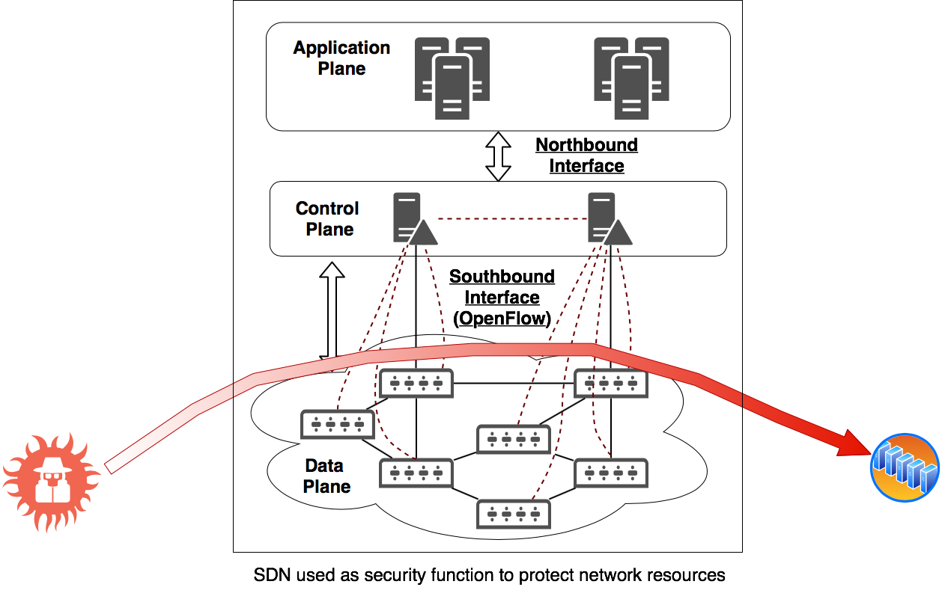
Background, Goals and Methodology
vs
Notes:
In [63], authors presented three levels of complexity to use cognition:
Reactive reasoning (rule-based reaction), Tactical reasoning (Profiling based on
classification with dynamic multi-objective optimization), and Strategical rea-
soning (Anticipation with online multi-objective optimization). The study pro-
poses to formulate optimization functions related to the security concerns in the
network.
On the other hand, in [28] authors presented a framework to provide au-
tonomous response and mitigation against attacks in an SDN/NFV network.
The approach is called SARNET and has a transverse loop with five stages:
Detect, Analyze, Decide, Respond, and Learn. An essential contribution of the
study is the definition of an efficiency estimation that allows measuring the per-
formance of the proposed framework. A group of simulations of different attacks
(UDP DDoS attack, CPU utilization attack, Password attack) showed that the
efficiency measure helps in selecting the best countermeasure.

Slide 6
Background, Goals and Methodology
To identify:
Network attacks
ML - Techniques & metrics
Tools to develop IDS with ML in SDN
Results:
Too few
Too many and diverse
Datasets for training and test tools
Objectives
Notes:
Methodology
Initial list of 200 papers
classified the articles into those to be used in the survey and those to be excluded by reviewing the abstract (70 papers)
Classification of papers into:
Surveys
Proposal for framework or security application
Experiment of existing tools

Slide 7
Background, Goals and Methodology
Methodology
200 papers (only with title review)
Select 70 papers (reviewing the abstract)
Classification of papers into:
Surveys
Proposal for framework or security application
Experiment of existing tools
Notes:
Methodology
Initial list of 200 papers
classified the articles into those to be used in the survey and those to be excluded by reviewing the abstract (70 papers)
Classification of papers into:
Surveys
Proposal for framework or security application
Experiment of existing tools

Slide 8
ML applications for SDN security

Slide 9
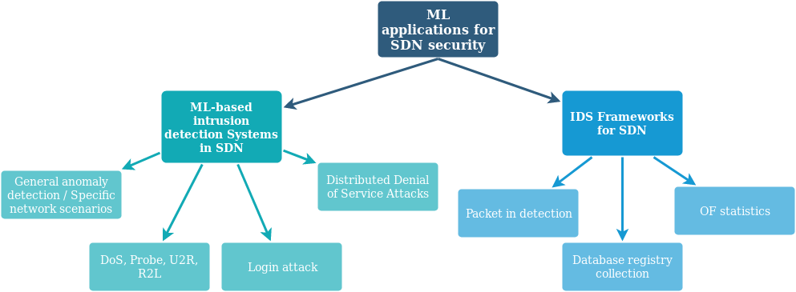
ML applications for SDN security
Only with a proposal of the detection model, with no implementation considerations
Include methods to collect data to feed the ML model, as well as mitigation schemes once the anomaly is detected
Notes:
Collection method: Packet-In detection

Slide 10
ML-based intrusion detection Systems in SDN
General attack & specific scenario (4)
RBM, Autoencoder, CUSUM, ANN, CNN, LSTM
KDD99
Custom
DDoS (6)
SVC, SVM, NB, KNN BEST, Gaussian and bayesian, DT, NEAT
Detected attack
Darpa99
DoS, Probe, U2R, R2L (5)
DT, ELM, NN, SVM, AdaBoost, LogitBoost, baggingTrees, NB, LDA, RT, KNN, RUSBoost, MHBNC, DNN, kNN, ELM, H-ELM, CPLE
NSL - KDD
Login (1)
C4.5, BayesNet, Decision Table (DT), and NB
LongTail

Slide 11
IDS Frameworks for SDN
KDD99
OF statistics (3)
Ranker, genetic and greedy.
GBDT, DT, SVM, KA
C4.5
Darpa99
NSL - KDD
Collection method
Packet-in detection (3)
Neural networks
Open *
UNB ISCX
Database (1)
RBM
Custom
Frameworks define the context for implementation conditions.

Slide 12
Complementary proposals, Datasets & Testbeds

Slide 13
Complementary proposals, Datasets & Testbeds
Additional considerations
Adversarial machine learning is a risk. Nyugen proposes:
1) Invest time and effort in the threat models while designing ML solutions,
2) Make the ML model auditable,
3) Follow a secure development process, and
4) Produce an initial operational cost model.
Apache spot is available
ML-based traffic classifiers can be useful
Emulation:
Mininet with Ryu, POX, Floodligth controllers (4)
Cbench + controller deployment (1)
Implementation with Opendaylight (1)

Slide 14
Conclusion and future work

Slide 15
Conclusion & future work
*
Just six specific attacks (DoS, DDoS, Probe, U2R, R2L, login), there is a need to explore more attacks.
50% of the ML techniques are neural network implementations
Less than 30% of the studies consider collection, all based on OF.
Only 25% propose mitigation techniques
There is a need to use updated datasets that allow the models to learn from the latest attacks
No test in operative network
Several ML techniques proposals, too diverse that requires classification
*
*
*

Slide 16
Motivation
SDN / NFV
KP for SDN, focused on security
Cyber-Security
Machine Learning

Slide 17
Thank you!

Slide 18
Background, Goals and Methodology
Application
Presentation
Sessión
Transport
Network
Data link
PHY
SDN vs OSI
Notes:
Separation of control and data plane
Openflow as enabler
flow is a set of packets with similar features that go from one
endpoint (or group) to another endpoint (or group) in a single direction

Slide 19
Background, Goals and Methodology
Seven threat vectors identified
Techniques proposed to defend specific parts of the architecture (planes or interfaces)
MTD
Secure application development
Data leakage prevention
Others…
Not extensive research to secure the SDN architecture using ML
Notes:
In [63], authors presented three levels of complexity to use cognition:
Reactive reasoning (rule-based reaction), Tactical reasoning (Profiling based on
classification with dynamic multi-objective optimization), and Strategical rea-
soning (Anticipation with online multi-objective optimization). The study pro-
poses to formulate optimization functions related to the security concerns in the
network.
On the other hand, in [28] authors presented a framework to provide au-
tonomous response and mitigation against attacks in an SDN/NFV network.
The approach is called SARNET and has a transverse loop with five stages:
Detect, Analyze, Decide, Respond, and Learn. An essential contribution of the
study is the definition of an efficiency estimation that allows measuring the per-
formance of the proposed framework. A group of simulations of different attacks
(UDP DDoS attack, CPU utilization attack, Password attack) showed that the
efficiency measure helps in selecting the best countermeasure.

Slide 20
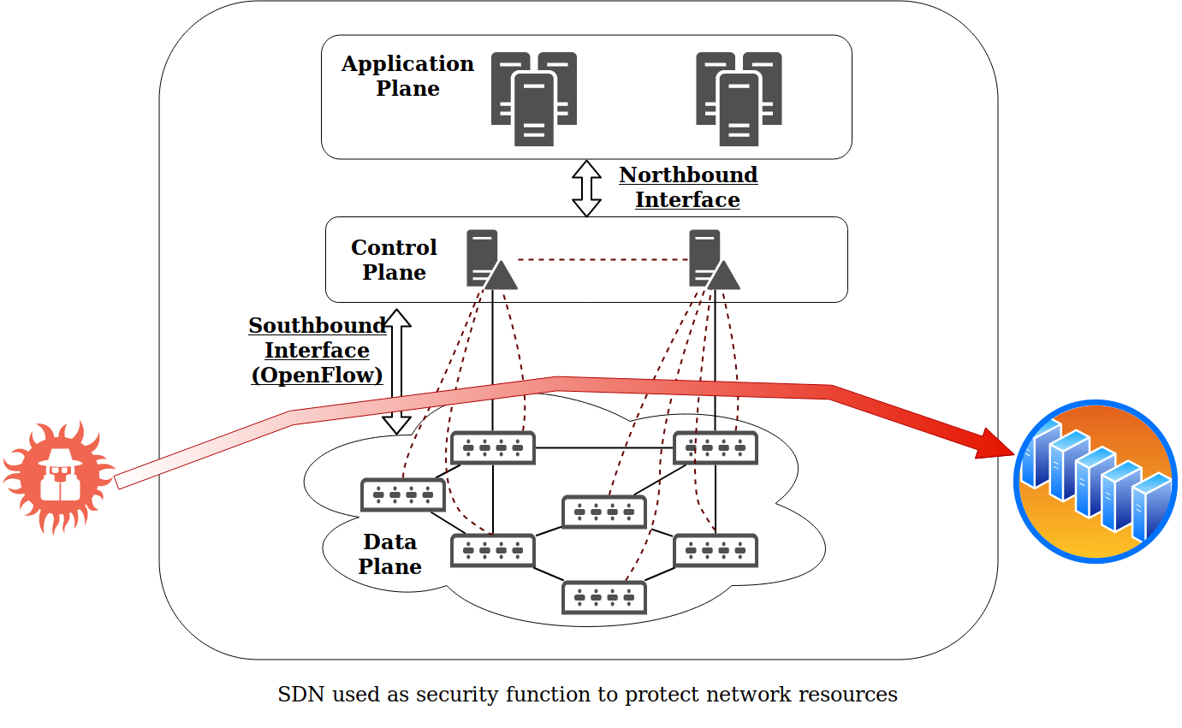

Background, Goals and Methodology
SDN as enabler for security functions.
The attacker does no target the network, but a resource
Security solution implemented as VFN

Slide 21
ML-based intrusion detection Systems in SDN
(9 out of 16) use a single ML technique, Neural Networks was used in 50% (RBM, NEAT, Generic NN, KNN, ANN, CNN). Accuracies from 75% to 99%.
Types:
General anomaly detection & Specific network scenarios
Login attack, DoS, Probe, U2R, R2L
Distributed Denial of Service Attacks
What about other attacks ? Man-in-the-middle (MitM), Phishing, Code injection, Eavesdropping, Malware ?
Notes:
Fundamentals of IDS operations apply equally for traditional and SDN environments.
Network IDS (signature based / anomaly based ) and Host IDS. For anomaly based, the features used are: Packet, flow, connection.

Slide 22
IDS Frameworks for SDN
Frameworks consider collection method, mitigation techniques and implementation
Only seven (7) out of the studied papers, presented a complete framework to implement in a network
Types of collection methods:
OF statistics,
database copy with forwarding.l2-learning command,
packet-in,
Mitigation based on of table modification from control plane or application (all proposals)
sFlow ?
MTD ?
Notes:
Mitigation proposals are based on of table modification, but damask presents an architecture in which the mitigation is located on the application layer of SDN

Slide 23
Reference | Collection method | PARA FW (mitigation) | Detection method | Feature selection | Metric | Training dataset | Scenario
Alshamrani2017 | OF based, packet recieved counter | Openflow table change from app level, according to detector recomendation | Sequential Minimal Optimization (SMO) | ranker algorithm, genetic algorithm, and greedy algorithm | accuracy: 99.40\% | NLS-KDD | SDN
Li2017 | OF based, regular intervals | Dedicated module to give instructions to switches | 1. Flow Statistical 2. 4 ML techniques tests (GBDT, DT, SMV, KA) | RF, Tree, Fisher, ReliefF | accuracy: Normal 98.54\% Probe 97.96\% DoS 99.97\% U2R 68\%, R2L 65.5\% | KDD-Cup 1999 | 5g networks
P.2017 | Incoming traffic flows from the data plane switches saved in POX database (forwarding.l2-learning) | Not defined | Restricted Boltzmann Machine based | Restricted Boltzman Machine | accuracy was 92\% | Owned. Not specified characteristics | SDN
Tang2018 | Flow collector (packet-in triggered) | Not defined | ﻿Gated Recurrent Unit Recurrent Neural Network (GRU-RNN) | Fixed: duration, protocol type, src bytes, dst bytes, srv count, dst host same src port rate | Accuraccy 89% | NSL-KDD dataset. | SDN
Cui,2016 | Abnormal packet-in messages (trigger to start ML detection) | New openflow table entries (highest priority) to drop traffic directed to target, OpenFlow modification message to clean the flow tables | Backpropagation neural network BPNN | Not declared. | time, cpu use and traffic due to the trigger method for detection | Owned. Not specified characteristics | SDN
Wang,2015 | Packet-in detection | Managed from app layer | Graph method | ﻿Chow–Liu algorithm. | Detection rate (%) Basic 74.02, Local 86.56, Global 89.30 | ﻿UNB ISCX dataset | Cloud
Le2015 | Openflow-based. Not defined | Not defined | C4.5 | 14 derivated from transport features from a basic set of 9 | IPS alert: 60% | ﻿Darpa 99 | SDN

Slide 24
Reference | Detected | Technique | Feature extraction | Accuracy | Dataset | Scenario
Latah2018 | DoS, R2L Probe, U2R, | DT, ELM, NB, LDA, NN, SVM, RT, KNN, AdaBoost, RUSBoost, LogitBoost and BaggingTrees | ﻿subset of features extracted from NSL-KDD dataset based on employing the well-known Principal Components Analysis (PCA) approach | Best accuracy ﻿from 77.09% to 88.74% | NSL- KDD | NA
Dawoud2018 | General anomaly | RBM | Fixed: all features in KDD99 DS | 94% of accuracy | KDD99 | IoT
Dawoud2018a | General anomaly | Autoencoder | Fixed: all features in KDD99 DS | Average precision: 99% | Not stated | SDN
Prasath2018 | MHBNC | meta-heuristic Bayesian network classification (MHBNC) | Preprocessing + feature extraction | Precision 77%, Recall 74%, and F-measure 75%, | NSL-KDD | SDN
Kokila2015 | DDoS | SMV | Grid search method | accuracy is 95\%. | 1999 DARPA dataset & 1998 DARPA dataset | SDN
Zhang2017 | ] Optical network | Point anomaly: probability-based. Sequence anomaly: CUSUM | Not declared. Features include data related to optical links. Examples are average bandwidth usage, frequent source and destination nodes, average route length, and modulation formats | accuracy of 83% | ﻿NSFNET | Optical SDN
Tang2016 | DoS, R2L Probe, U2R, | ﻿Deep Neural Network (DNN) | Fixed: duration, protocol\_type, src\_bytes, dst\_bytes, count and srv\_count | ﻿accuracy of 75.75% which | NLS KDD | SDN

Slide 25
Reference | Detected | Technique | Feature extraction | Accuracy | Dataset | Scenario
Wang2017 | SYN Flood DDoS | SVC | Iterative Dichotomiser 3 (ID3) | 0.97 | KDDCUP99 | SDN
Latah2018a | DoS, R2L, Probe, U2R, | kNN, ELM) for the second level, and H-ELM | 6-flow-based features | Accuracy 84.29% | NSL-KDD | SDN
Prakash2018 | DDoS | NB, KNN BEST and SVM | 6 fixed features Packets, Protocol, Delay, Bandwidth, Source IP and Destination IP | Detection rate: K-nearest 97%, Naive bayes: 83%, SVM: 82% | Owned. 6000 data samples | SDN
Raj2018 | Crossfire | ANN, CNN, LSTM | Fixed: Number of flows, Aggregate flow size, Timestamp | Accuracy, Precision, Recall, F1-Score measure depending speed and vehicle quantity | Owned ( | cross-fire attack - ITS
Neupane2018 | DDoS | ensemble learning with multivariate Gaussian and bayesian | src_ip, dst_ip, no_of_packets, spoof_dst_ip, blacklist_ip | Accuracy: over 98% | Owned | cloud
Wang2018 | DoS, R2L, Probe, U2R, | contrastive pessimistic likelihood estimation (CPLE) | 6 features vs 41 features | Accuracy: one per technique and # of features | NSL-KDD dataset. | Wireless SDN enable E-Health
Gangadhar2017 | DDoS | DT, SVM, and NB | source IP address, destination IP address, source port,destination port, protocol and reduce space withPCA | Accuracy, precision, recall (best: 99% for DT) | MIT KDD 1999 dataset. | SDN
Smith2016 | DDoS & Worm | Neuro-evolution of augmented topologies NEAT | Fixed: packet level: IP, port | Detection rate: worm 90\%, DoS 80\% | Owned: about 800000 packets | SDN

